Slide 1
Self-Learning Tutorial
James Holbrook
AI Healthcare

Slide 2
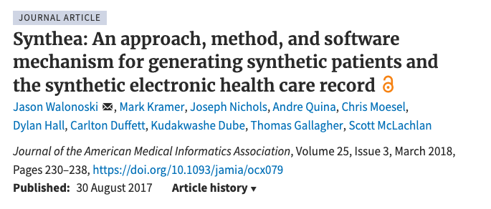
Dataset
This tutorial uses Synthetic Medical Data. It is not real patient data, but generated through Synthea
Notes:
Source of data:
https://data.world/siyeh/synthetic-medical-data
Method to obtain data:
https://academic.oup.com/jamia/article/25/3/230/4098271?login=false

Slide 3
Goal: Attempt to better predict certain conditions with patient conditions.
Method: Random Forest Ensemble Classifier
Conditions to predict:
Cold/Respiratory cognition
Diabetes
Physical injury (sprain, fracture, concussion)
Heart Condition
Notes:
These four conditions were grouped using similar descriptions. More details to follow later in the presentation.

Slide 4
Data Preparation

Slide 5
Three Datasets
Conditions
Patients
Observations
Notes:
Talk about description column. There are 5 conditions listed with 2 being the same and 3 dealing with respiratory/cold symptoms.

Slide 6
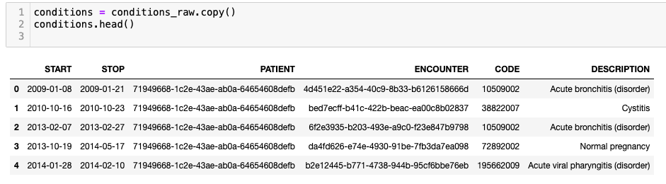
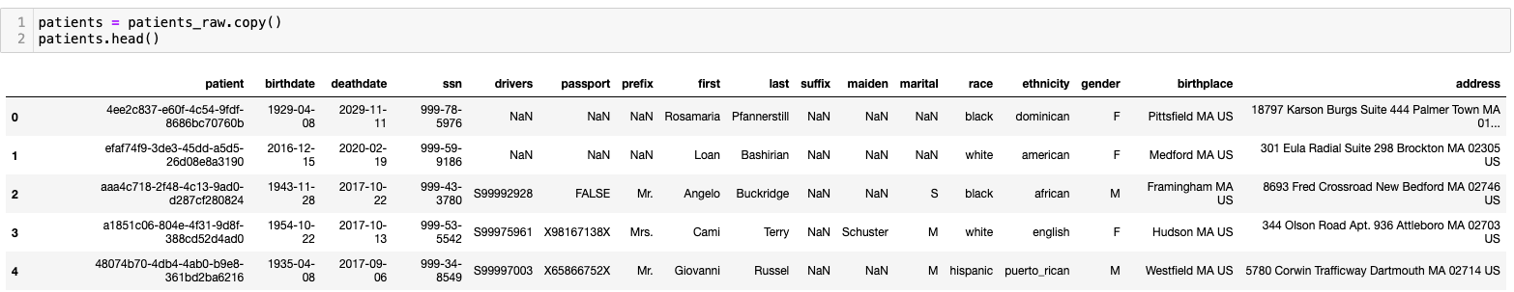
Conditions
Notes:
Talk about description column. There are 5 conditions listed with 2 being the same and 3 dealing with respiratory/cold symptoms.

Slide 7
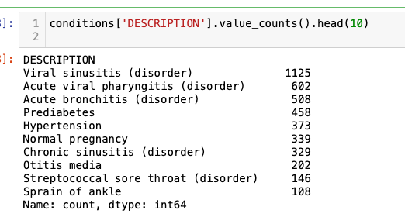
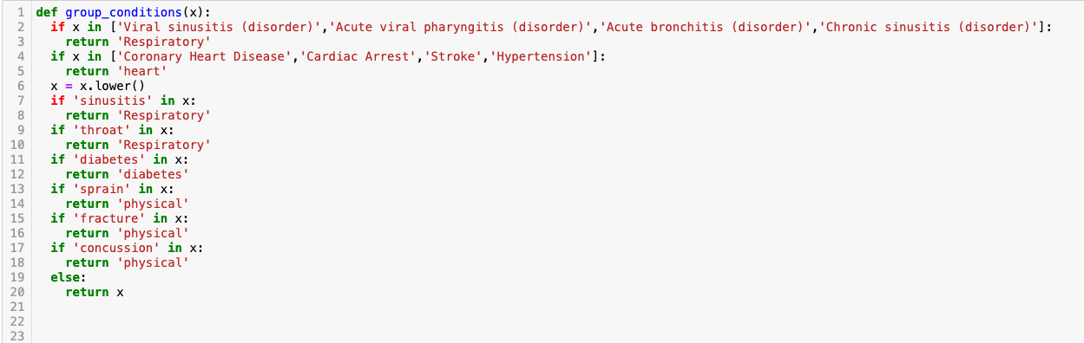
Conditions
Notes:
Talk about the long tail of conditions and how they could be grouped together before going over function.

Slide 8
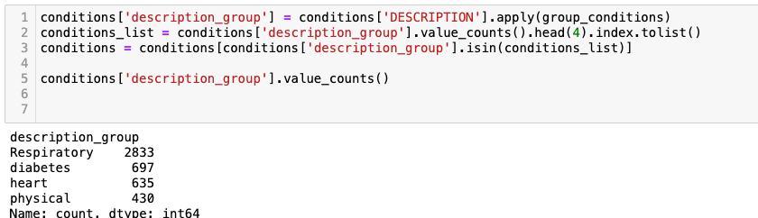
Conditions
Notes:
This will be the target variable

Slide 9
Patients
Notes:
Let the audience view the data and call out certain properties: birthdate, race/ethnicity, gender.

Slide 10
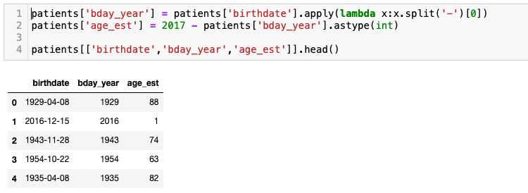
Patients
Notes:
Feature creation from patients. This makes an assumption and assumes the conditions were observed in 2017 which is the latest date in this dataset.

Slide 11
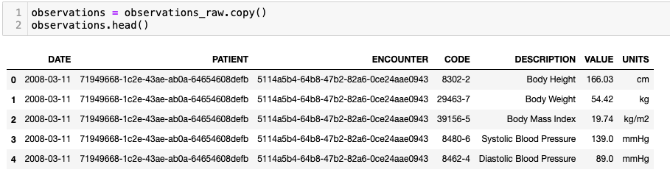
Observations
Notes:
Notice how this one patient has multiple rows per encounter. Talk about the descriptions and how they could be used as features.

Slide 12
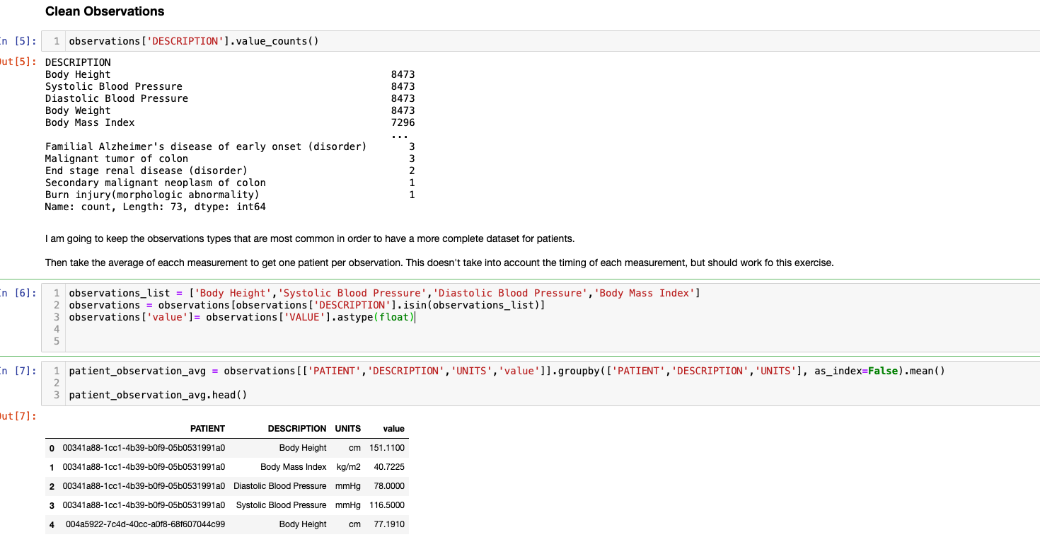
Observations - Data Transformation
Notes:
Talk about the gaps in this method. It’s taking the mean instead of a point in time observation which might not be as useful.

Slide 13
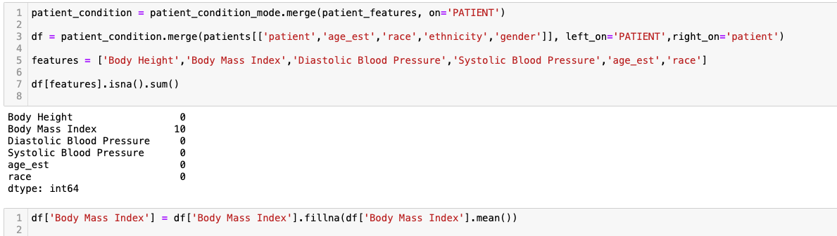
Combine and Fill NAs
Notes:
There are 10 NA values for BMI. Rather than remove those rows, I am filling with the mean since it’s such a small percentage of the training set.

Slide 14
Modeling

Slide 15
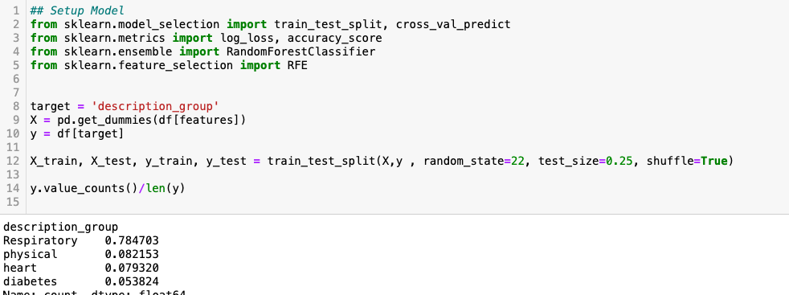
Model Setup
Notes:
This is clearly an imbalanced dataset. This isn’t ideal for this model, but that is usually the case with real-world data.

Slide 16
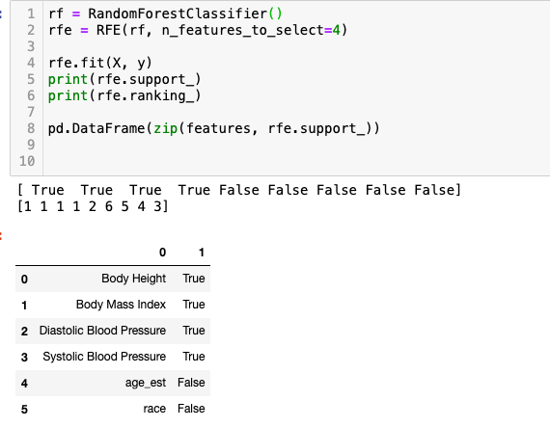
Feature Selection
Notes:
Walk through this code so the audience has to understand what the output means rather than just listing the features. RFE, support, and ranking should all be covered but try to make it interactivel

Slide 17
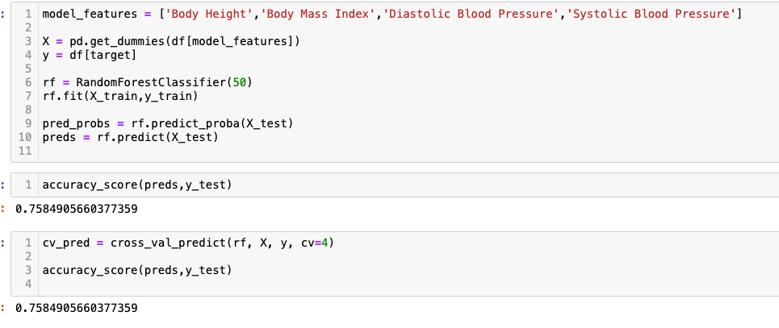
ML Model
Notes:
The model accuracy is less than a baseline in this case. This is common in the real world but that does not mean the model is worthless. Walk through this code. Make sure to touch on
Features
Get_dummies
predict vs predict_proba
accuracy_score
Cross_val predict

Slide 18
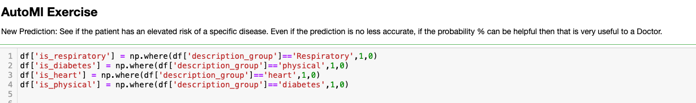
Multiple Models at Once
Convert multiclass to binary model
Run cross-val-predict for binary and probability output
Compare to baseline
Notes:
This walks through the high-level plan of the code without showing any of it (next slide).

Slide 19
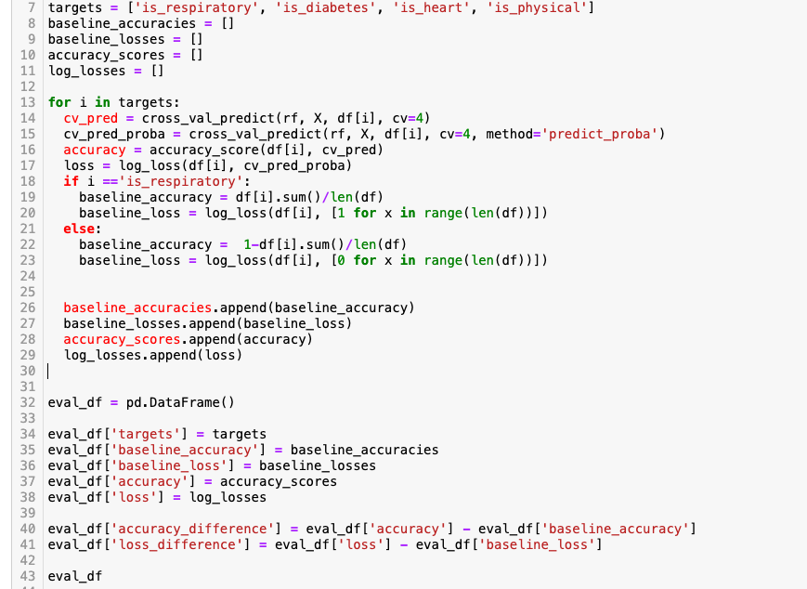
Notes:
Only putting code on this slide because it’s a lot. Depending on time, speaker can walk through this in detail or give a quick theoretical overvie.

Slide 20
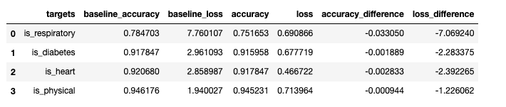
Output and Takeaways
For accuracy, it is hard to beat the baseline.
The loss, however, is much lower/better when using probabilities.
This is an example of how predicting risk/likelihood is a much more useful output than a binary/categorical prediction that has no context.
Notes:
Results from previous slide. Make sure audience understand through loss vs accuracy. Focus on one condition for example (heart).

Slide 21
Final Thoughts
It is hard to accurately make patient predictions using ML without proper data.
An average model can still be useful to a provider if it contains a % prediction. For example, a 40% prediction on condition that 10% of the population has is very high risk even if it’s less likely the patient has the condition.
Notes:
Make sure to hammer home the point of the model. In the real world, predictions are rarely neat and need context. The main takeaway should be the audience understand that ML isn’t a magic wand that does a doctors job, but a tool that can greatly help providers.

